Slide 1


Automate to Innovate Simplifying z/OS Management with Python and ZOAU
Steven Perva
Sr Mainframe Innovation Engineer
Ensono
stevenperva
Dan Jast
Sr Product Manager
IBM
daniel-jast .

Slide 2
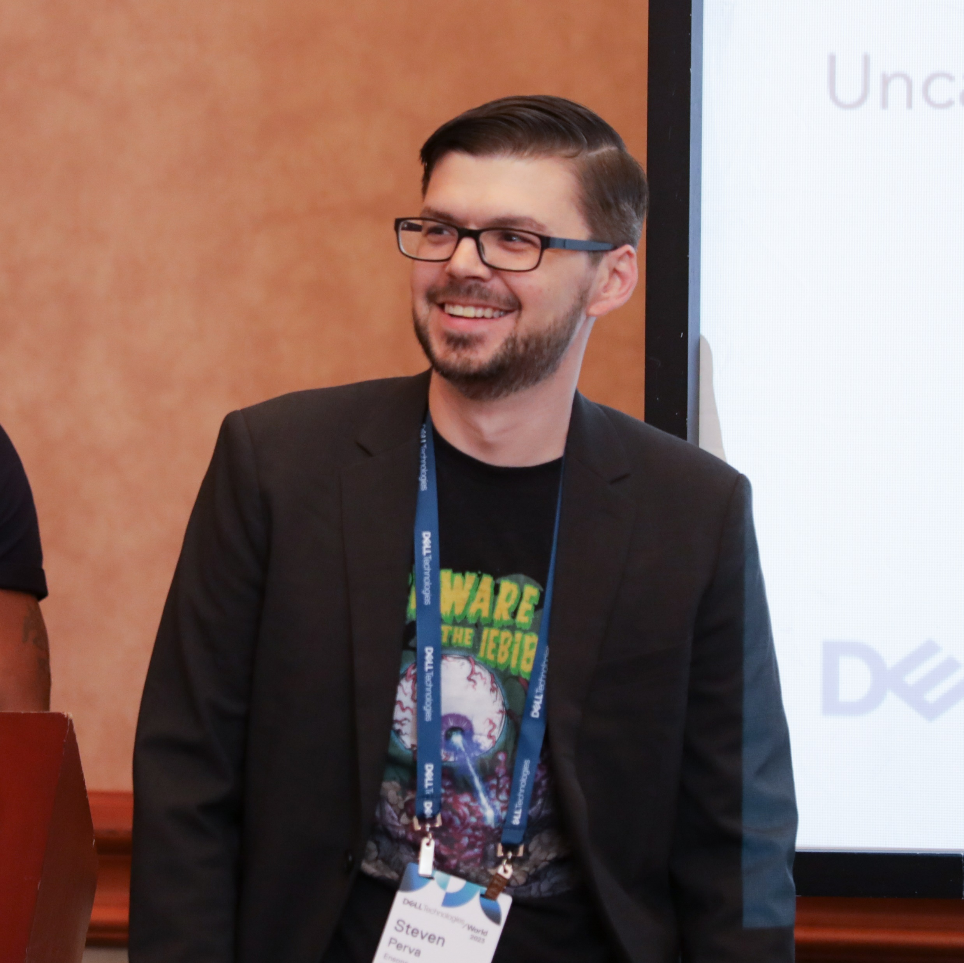
Steven Perva
Hobbyist Developer (video games, productivity tooling, etc.)
Sr. Mainframe Innovation Engineer at Ensono
IBM Champion for IBM Z ‘22-’23
Mainframe Evangelist, Advocate, Community Builder
z/OS System Admin. (Systems Programmer)

Slide 3

Dan Jast
Senior Product Manager and has been at IBM for 6 years
Supports offerings for IBM Z including the IBM Z and Cloud Modernization Stack, Ansible for IBM zSystems, z/OS Cloud Broker, ZOAU and more
I enjoy working on solutions that help make working with z/OS a consistent experience from other platforms
Outside of work I am a huge Yankees fan and enjoy spending time by the water

Slide 4










Ensono is an ally for better outcomes
Our portfolio of services:
Global advisory and consulting
Hybrid and multi-cloud
Mainframe and distributed systems
Cloud native applications
230+
$1B–$25B
Offered in our clearly defined service model:
clients
in size
2,800+
$800M+
experts
global revenue
Design
Build
Migrate
Run
Secure
Managing and modernizing today’s systems, creating tomorrow’s cloud advantage.
We make better happen faster.
Powered by a platform that provides governance and a hybrid service experience:
Ensono Envision®

Slide 5

z/OS Strategy: Looking to the future
Vision: For z/OS® to be a vibrant choice of platform in a hybrid multicloud world
Mission:
To provide a cloud native experience for IBM z/OS that is consistent and familiar to developers and operators
Delivered by integrated offerings & capabilities across the portfolio
Developer productivity
Shift left testing capabilities
Red Hat® Ansible® Automation Platform
IBM Z and Cloud Modernization Stack
API economy
z/OS & Middleware Containerization
Language support (Python, Go, etc.)
Operations and Observability
And more ...
Notes:
Consistent standard experience for people using zOS
Consistent with how it works on other platforms
Building out offerings that are standards across the industry and not just Z
Specifically we’re talking about language support (Python, Go, Node.js, etc.)

Slide 6







Why Ensono Cares
Lower Barrier to Entry
Automation @ Scale
Platform Agnostic Management
Facilitates Knowledge Transfer
Lowers Time-to-Productivity
Invigorates New Talent

Slide 7


Python and ZOAU from 10,000 ft.
IBM Z Open Automation Utilities (ZOAU)
Python
Simple programming syntax, rich ecosystem of packages, capability to interact with other languages and platforms
Develop applications the same way as you would on any other platform, leveraging common skills that are widely available
Embrace newer application platforms that allow you to experiment and develop new digital experiences quickly and at low cost
Develop data science applications natively on IBM z16 for faster performance with better security
Provides a command-line interface with full capabilities to z/OS resources
Enables z/OS developers to leverage common tooling to script automation
Exposes z/OS services in an easy-to-consume manner
Enhances other IBM offerings such as IBM Open Enterprise SDK for Python, IBM Open Enterprise SDK for Node.js and Red Hat Ansible Certified Content for IBM Z
Continuously updated and enhanced
Notes:
What is Python
What is ZOAU
Command line interface
Access to MVS side of resources
Customizability with how we access those resources
Serves as a foundation for Ansible work
Provides Application Programming Interfaces

Slide 8

Options for Obtaining Python and ZOAU
ShopZ:
Python:
5655-PYT for the base product
5655-PYS for service and support
ZOAU:
5698-PA1 for the base product
5698-PAS for service and support
Mainframe downloads here
PAX downloads
ZOAU Packaged in:
ADCD (Dev/Test)
IDzEE (Dev systems)
ADFz
Both Packaged in:
IBM Z and Cloud Modernization Stack
Current Versions (as of presentation):
Python: 3.11.4
ZOAU: 1.2.4.5
Check Your Versions:
python –version
zoaversion
ZOAU
Python
Notes:
Variety of ways to get the packages
Everything is available for SMPE install with the PIDs for both
You may have it already
Mainframe Downloads Page
Both bundled in the Z and Cloud Modernization Stack
I would recommend that you just fetch these packages yourself instead of the tight coupling
Check the current versions

Slide 9
Enabling the Tools
Check if you have them already:
python –version
zoaversion
Check /usr/lpp/IBM for:
zoautil
cyp
If you can find them but the commands aren’t working:
Edit your profile! (or /etc/profile)
Profile Additions:
# Auto-conversion variables
export _BPXK_AUTOCVT='ON'
export _CEE_RUNOPTS='FILETAG(AUTOCVT,AUTOTAG) POSIX(ON)'
# File Tagging variables
export _TAG_REDIR_ERR=txt
export _TAG_REDIR_IN=txt
export _TAG_REDIR_OUT=txt
# Python Stuff
export PYTHON_HOME=/usr/lpp/IBM/cyp
export PATH=$PYTHON_HOME/bin:$PATH
export LIBPATH=$PYTHON_HOME/lib:$LIBPATH
# ZOAU Stuff
export ZOAU_HOME=/usr/lpp/IBM/zoautil
export PATH=$ZOAU_HOME/bin:$PATH
export LIBPATH=$ZOAU_HOME/lib:$LIBPATH
export MANPATH=$ZOAU_HOME/docs/%L:$MANPATH
Notes:
Check if you have them
Here’s where to look if they’re not returning anything just to double-check
Here’s how you set them up once you have everything laid down (or located)
You may have to do some checking for APF authorization on some of the modules
Extended attributes
Just look at the IBM documentation on how to validate and do that

Slide 10
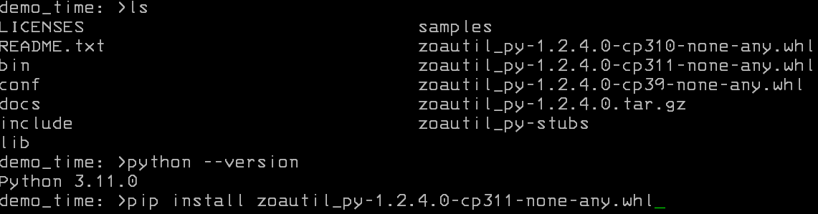
Installing the ZOAU Module in Python
Forget about the compiler bits!
Wheels make things go fast!
Install faster.
Smaller (no source).
Avoids building packages.
No more spooky setup.py riddlebox!
Notes:
So if you’ve done the API enablement in the past – don’t bother with all the complicated stuff
Go straight for the wheel file
Wheels are basically binary distributions
Wheels make things go fast by:
Installing faster
Faster distribution by being smaller packages because they don’t contain the source
They also avoid the compilation of dependent binaries

Slide 11
Some Notable Updates
ZOAU:
NEW zoau_io Python module
granular, record-level support for data sets (read-only at the moment)
Job management enhancements (more attributes, more control over returned output)
Data set copy enhancements (alias support, force option for automation use cases)
Binary read Phase 1 (dtail supports direct unprintable NULL bytes)
Samples (Python, C API)
Stubs for VSCode
IBM Open Enterprise SDK for Python:
ZIIP Eligibility
IBM C/C++ For Open Enterprise Languages on z/OS® 2.0 is available and can use with IBM Open Enterprise SDK for Python 3.11
zEnterprise® Data Compression(zEDC) support is available for IBM Open Enterprise SDK for Python 3.11
Notes:
ZOAU IO Python Raw binary read-only for now data set support, step in the direction for binary read capability.
Stubs for vscode

Slide 12
Some New Helpful Commands
Command
Description
dcat
Print out a non-VSAM dataset
dhead
Print head of non-VSAM dataset
jls -l
Long listing of jobs(addtl. fields)
Notes:
dcat “SYS1.SAMPLIB(HELLO)”
dhead “SYS1.SAMPLIB(HELLO)”
dhead –n 1 “SYS1.SAMPLIB(HELLO)”
jls –lv ‘/SMFDAILY’

Slide 13
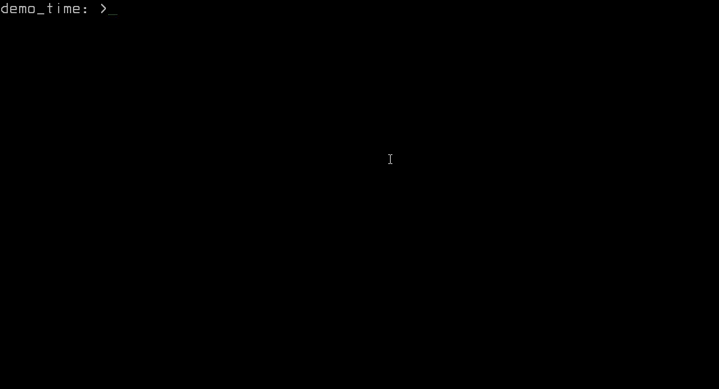
New Commands Demo

Slide 14

Rapid Prototyping Example
Perform a simple operator command
Ingest the results and serialize them
Return the result set as a JSON object

Slide 15

Rapid Prototyping Demo

Slide 16
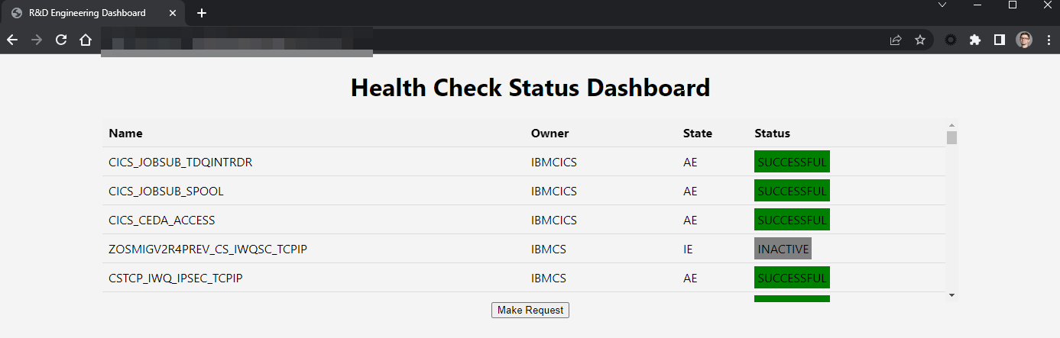
Rapid Prototyping Demo

Slide 17

ZOAU and Python are foundational to Ansible for z/OS
ZOAU and Python are requirements for IBM z/OS Core + IMS Collections
See some of Ensono’s presentations about Ansible on z/OS for further information
Automation and Infrastructure as Code at scale!
Join the Ansible community to get involved
Notes:
How this serves as the foundation for connecting ansible to zOS
Shipping python payloads that execute on zOS under the covers
Being familiar with this helps you understand how existing core and IMS collections works
Once you get this, any script can serve ultimately as ansible module/role later down the line through private automation hubs.
You can still host these modules for your organizations using Python and ZOAU

Slide 18

Contribute your scripts today!
Contribute sample scripts with ZOAU here: https://github.com/IBM/zoau-samples
Participate in GitHub discussions to drive direction and priorities
Contribute Ansible playbooks here: https://github.com/IBM/z_ansible_collections_samples

Slide 19
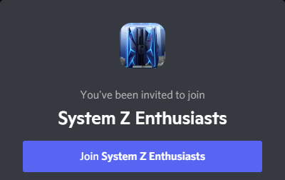
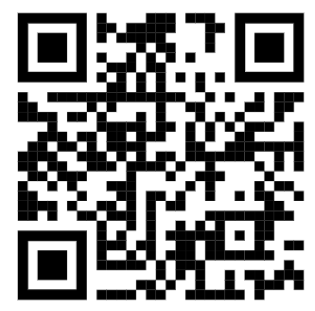
Additional Resources
ZOAU Documentation https://www.ibm.com/docs/en/zoau
ZOAU GitHub Samples https://github.com/IBM/zoau-samples
IBM z/OS Open-Source Guild https://github.com/ZOSOpenTools/meta/discussions
ZOAU Node GitHub https://github.com/IBM/zoau-node
System Z Enthusiasts Discord Community https://discord.gg/rFXEVKK7AH
Ansible Community ibm.com/community/z/software/ansible-for-ibmz
https://discord.gg/rFXEVKK7AH

Slide 20




Questions / Comments / Sharing

Slide 21



Your feedback is important!
Submit a session evaluation for each session you attend:
www.share.org/evaluation
SHARE mobile app
www.share.org/evaluation
21
21
Notes:
Please include this slide at the end of your presentation!

